Slide 1


Slide 2

Company Overview
Founded in 2007 as a peer-to-peer lending platform.
Became a full-service digital bank after acquiring Radius Bank in 2021.Based in San Francisco, California
Offers personal loans, auto refinancing, and other consumer loan products.
Provides high-yield savings and checking accounts through a mobile app.
Only full-spectrum fintech marketplace bank and the first public US neobank.
Serves consumers looking for low-fee, digital-first banking.
Uses data-driven underwriting to decide loan eligibility and design products.

Slide 3

Core Business Model Components
Digital Platform:
Fully online operations
Uses tech and data to lower costs and offer better rates
Integrated Services:
After acquiring Radius Bank, offers both loans and banking in one place
Data & AI Strength:
Uses data and machine learning for fast and accurate credit decisions
Hybrid Loan Funding:
Mixed model: keeps some loans, sells others to banks and investors

Slide 4
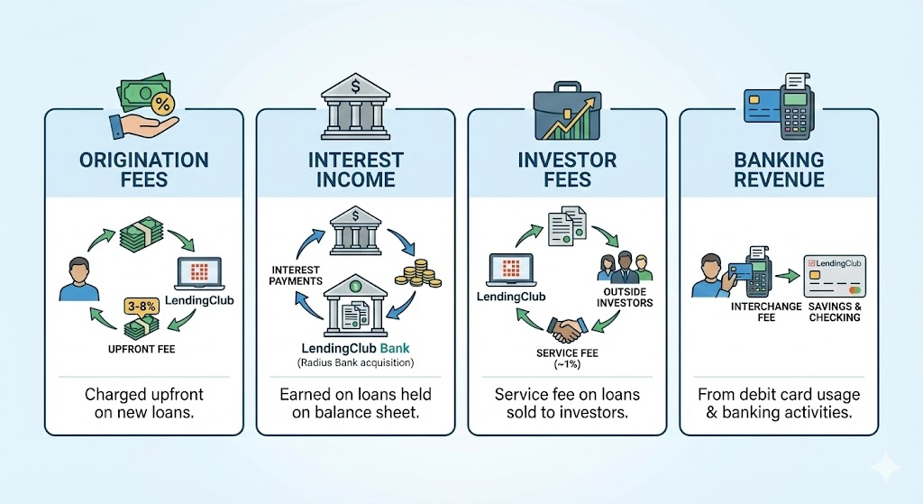

Revenue Streams

Slide 5
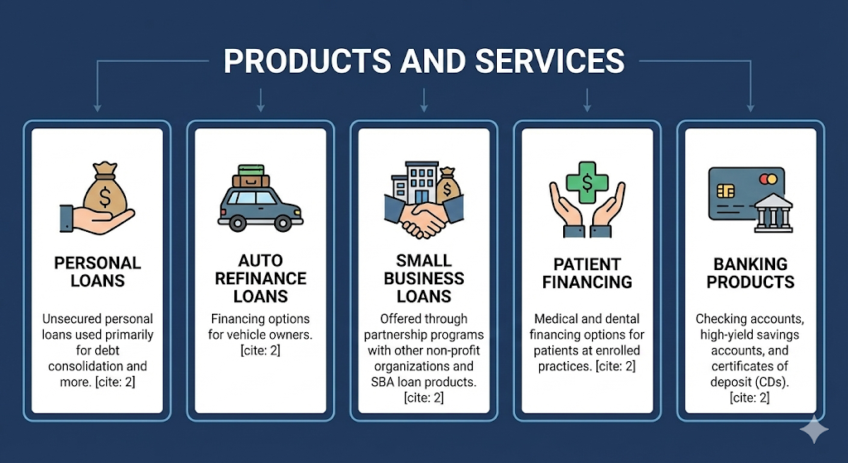
Diverse Product Portfolio

Slide 6

Fintech Underwriting: AI-Driven Solutions
Data-Driven Risk Scoring:
Uses machine learning and alternative data for more detailed credit assessment.
Speed & Automation:
Automated underwriting enables fast approvals with low manual effort.
Predictive Accuracy:
Broader datasets help better predict default risk, especially for near-prime borrowers.
Dynamic Model Updating:
Models are updated frequently using real-time loan performance for adaptive risk management.

Slide 7

Solving Financial Frictions Effectively
High-Cost Consumer Debt Refinances high-interest credit card balances with lower-rate personal loans.
Slow, Paperwork-Heavy Credit Approval Replaces long, manual underwriting with instant decisioning using automation and ML models.
Limited Access to Credit for Mid-Prime Borrowers Specializes in the under-served FICO 620–700 segment using nuanced risk analytics.
Fragmented Digital Banking Experience Combines deposit banking, lending, and financial wellness in one digital-only ecosystem.
Investors’ Search for Yield Provides marketplace investors access to high-yield consumer loan assets.

Slide 8

Risk and Regulatory Environment
8

Slide 9

Macroeconomic, Credit, and Business Model Risks
Macroeconomic & Credit Risks
Downturn Sensitivity: High default risk as >80% of loans are unsecured personal loans.
Concentration Risk: Limited diversification creates heavy exposure to consumer-credit conditions.
Operational & Business Model Challenges
Efficiency Issues: High operating costs and low returns persist despite strong net interest margins.
Competitive Pressure: Rivals (banks/fintech) squeeze pricing and borrower acquisition.

Slide 10

Regulatory, Governance, and Security Risks
Regulatory & Legal Risks
Historical Actions: Includes past regulatory issues, such as the FTC settlement regarding fee disclosures and withdrawals.
Future Uncertainty: Exposure to potential litigation or regulatory changes (e.g., rate caps) that may increase costs.
Governance Risks
Legacy Issues: The 2016 leadership scandal (involving data integrity and conflicts of interest) damaged investor trust and highlighted vulnerabilities.
Data Integrity & Security Risks
Cyber Defense: Must rigorously guard against cybersecurity threats and maintain controls to protect customer data and system integrity.

Slide 11

Regulatory Compliance Framework
Banking Regulations Overseen by OCC, FDIC, and state regulators; mandates capital adequacy, liquidity, and stress testing guidelines.
Consumer Protection Adheres to CFPB, TILA, ECOA, FDCPA, and FCRA to ensure transparent pricing and risk disclosures.
SEC Regulations Requires detailed investor disclosures (prospectuses, loan performance) and regular financial filings (10-K, 10-Q).
Data Security & Privacy Follows GLBA and cybersecurity standards; regulatory complexity is substantially higher now that LendingClub is a bank.

Slide 12
Competitive Landscape Analysis
12

Slide 13
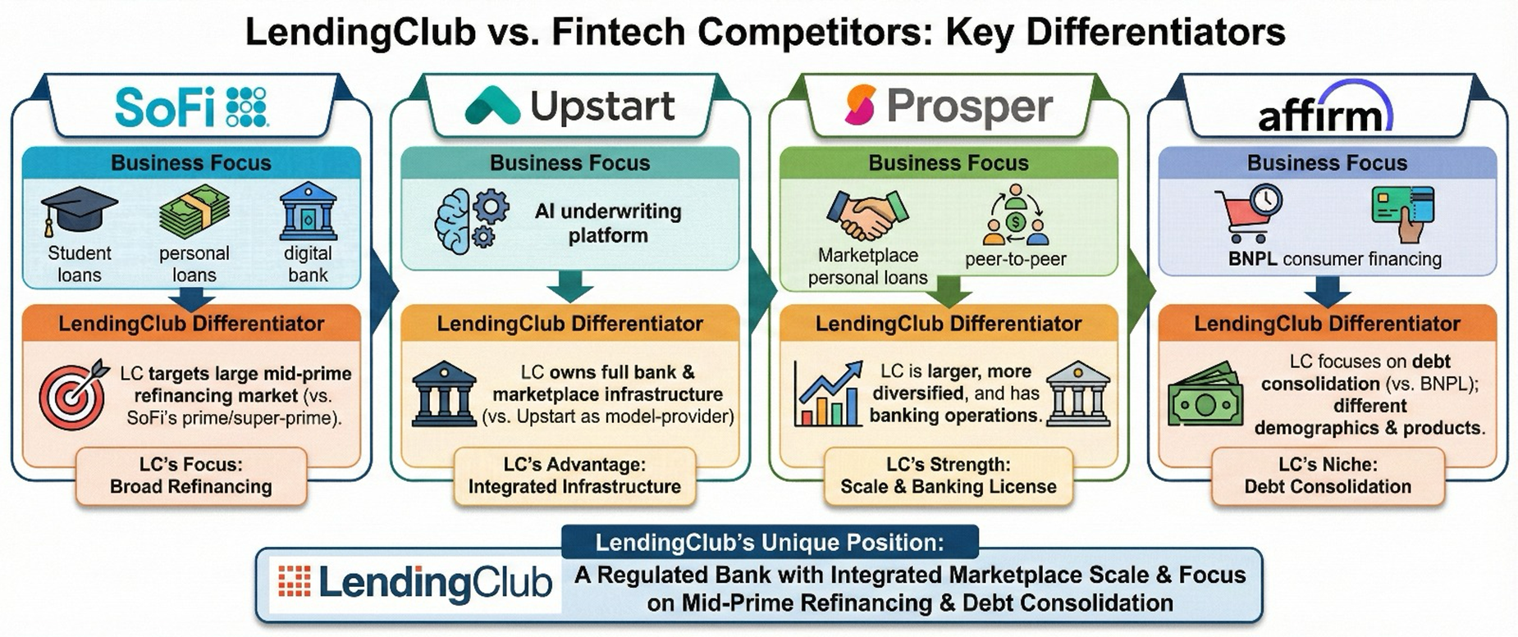


Slide 14
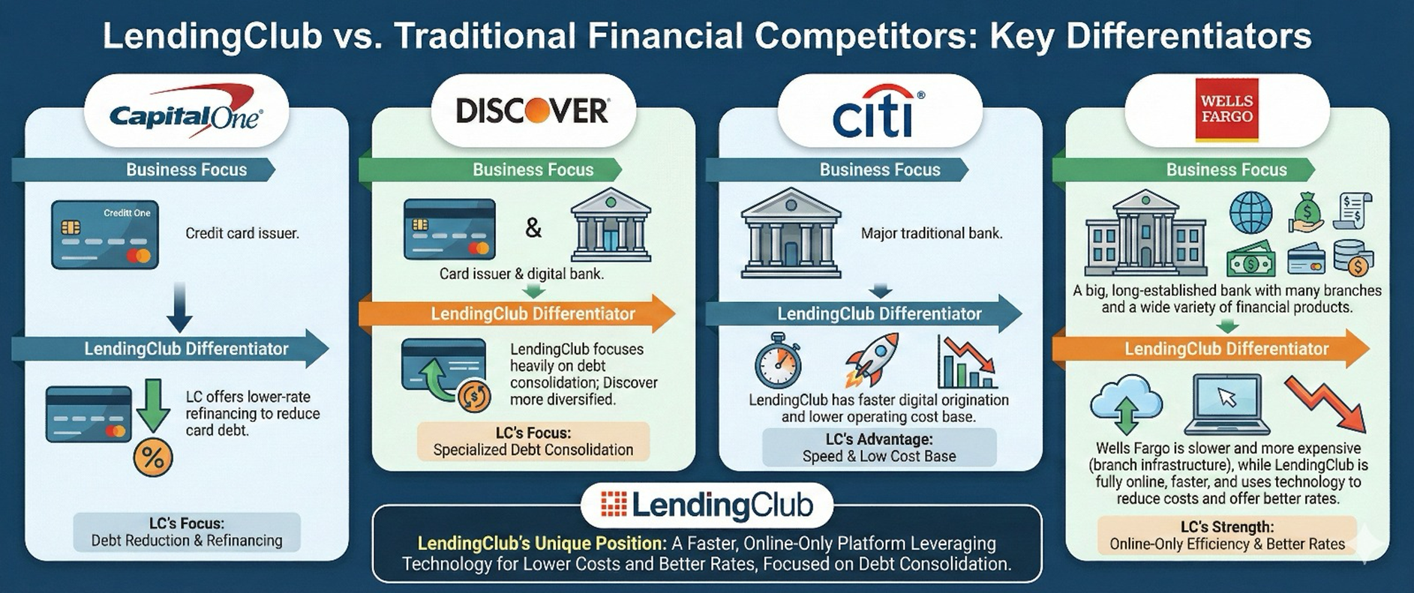

Slide 15
Quantitative Analysis
15

Slide 16
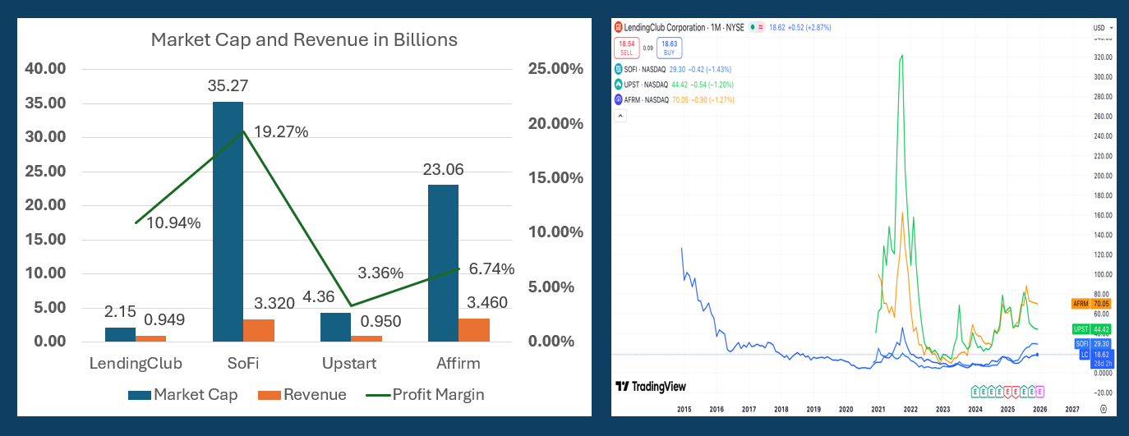
Fintech Competitors

Slide 17
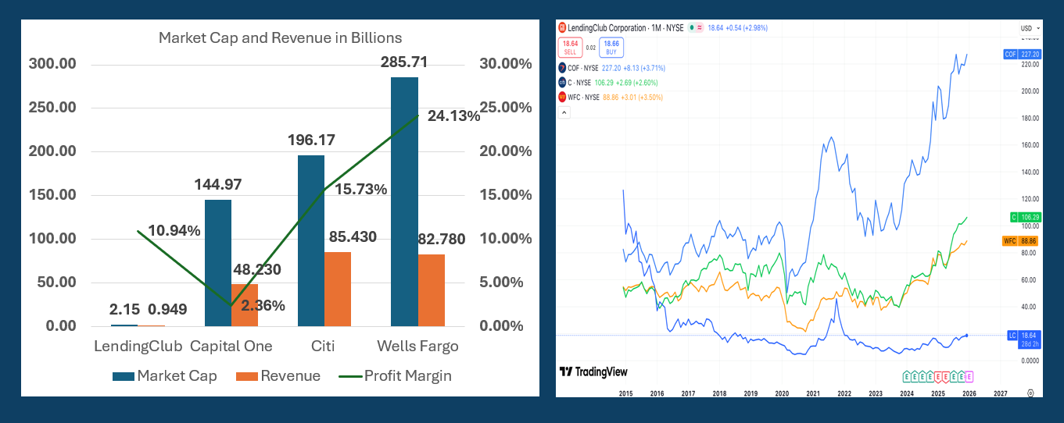
Traditional Competitors

Slide 18
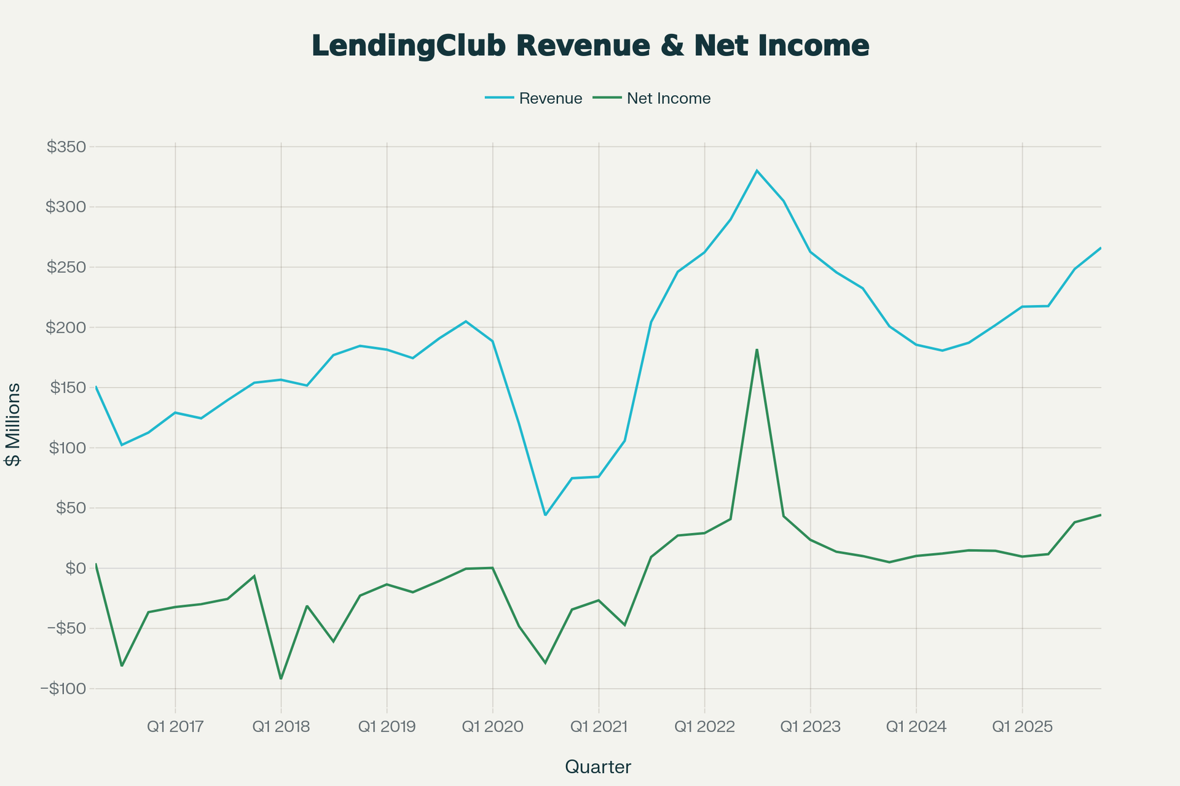

Slide 19
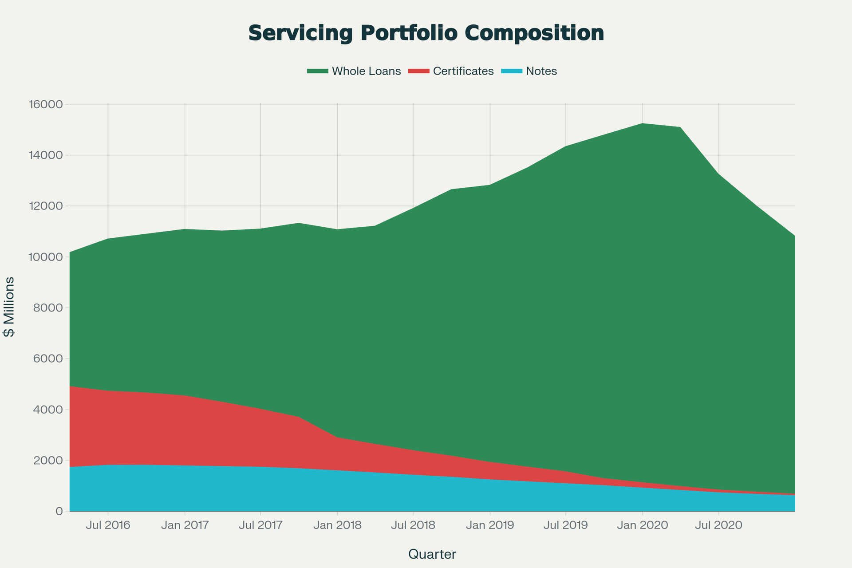

Slide 20
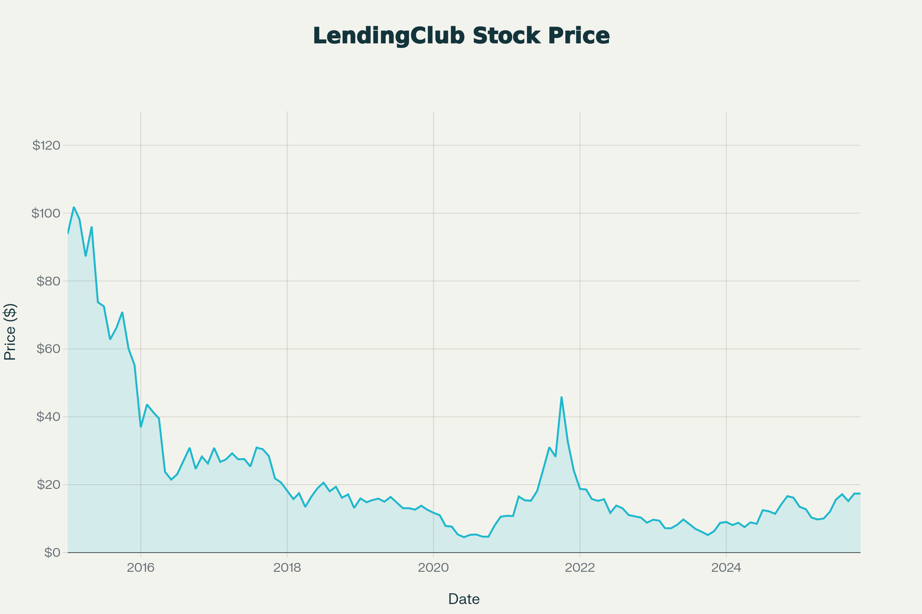

Slide 21
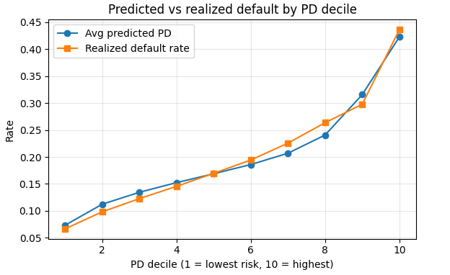
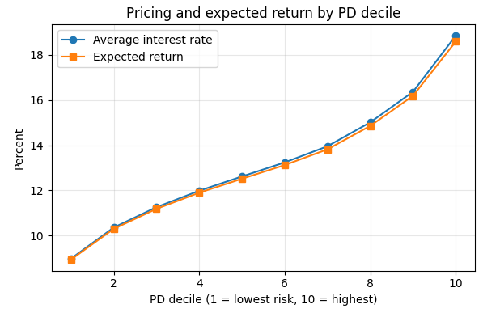
Risk‑based pricing: linking PD, rates, and expected returns

Slide 22
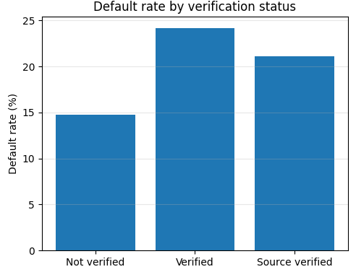
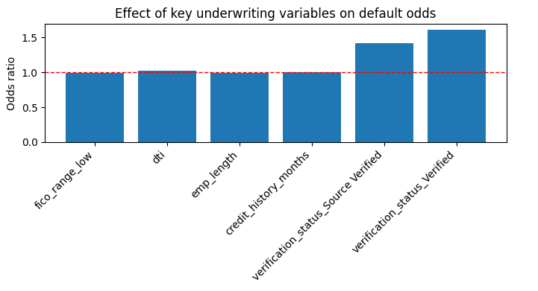
Underwriting effectiveness and screening

Slide 23
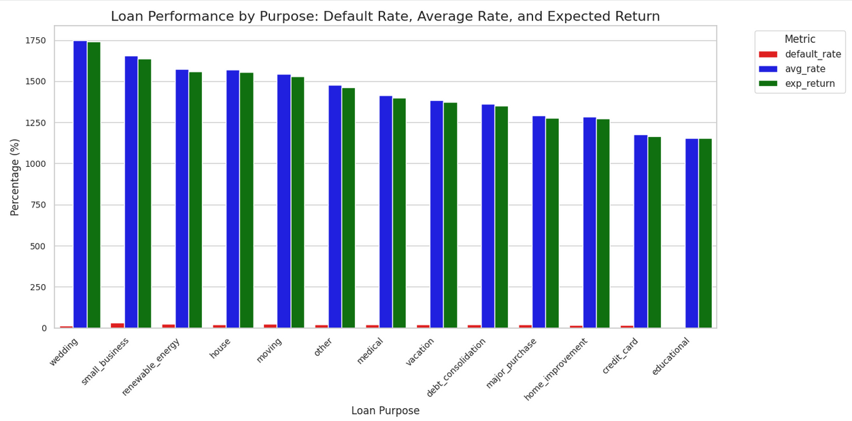
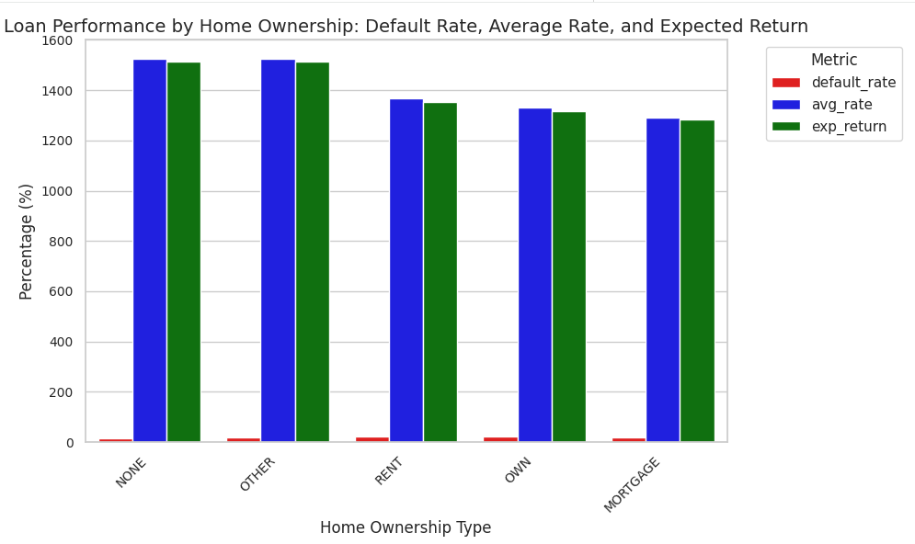
Segment performance

Slide 24

Challenges and Risks
Credit Cycle Sensitivity: Rising defaults reduce interest income and dampen investor demand for loans.
Funding Mix Risk: Reliance on marketplace investors creates instability during uncertain economic times.
Regulatory Burden: Maintaining bank status requires strict compliance and increases operating costs.
Competitive Pressure: Faces competition from agile fintechs and traditional banks with larger scale.
Interest Rate Volatility: Higher rates reduce consumer demand for refinancing, a core business driver.

Slide 25
Strategic Growth Recommendations Ahead
25

Slide 26

Long-Term Strategy and Growth Opportunities
Deepen Digital Banking: Grow deposits to lower funding costs and cross-sell loan products.
Expand Auto Refinancing: Target a fragmented market using AI-driven underwriting.
AI-Enhanced Credit Analytics: Optimize risk-based pricing to outperform traditional lenders.
Recapture Retail Investors: Re-engage retail investors through new SEC-compliant structures.
Expand into SMB Lending: Leverage marketplace distribution for small business credit (long-term).
Strategic Partnerships: Collaborate with neobanks and BNPL firms to drive customer acquisition.

Slide 27
Recommended Growth Strategy
Strengthen Deposit Base: Enhance UX and automation to grow deposits and reduce institutional dependency.
AI and Data Advantage: Invest in ML to improve loss rates and monetize analytics via Data-as-a-Service.
Maximize CLV: Drive retention through credit tools, budgeting features, and personalized offers.
Modular Marketplace Expansion: Enable third-party bank origination on the platform while retaining loan-level control.

Slide 28
Conclusion
Unique Hybrid Position: Evolved from a P2P lender to a regulated digital marketplace bank.
Competitive Edge: Advanced underwriting and data-driven operations provide an advantage over traditional lenders.
Key Risks: Remains exposed to economic cycles, regulatory pressures, and scale disadvantages compared to major banks.
Growth Drivers: Opportunities lie in deposit expansion, product diversification, and embedded finance partnerships.
Future Outlook: Well-positioned to lead in digital consumer lending through sustained investment in tech and risk management.

